Slide 1
Leonville
Junjie Xu Mohamed Mohamed Sumera Khan
Thomas Wrobel
Connor Trader

Slide 2
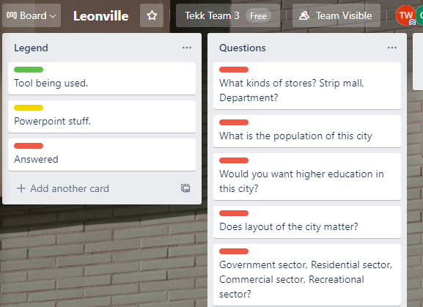
First Sprint
All members signed up for Trello and created a board (Leonville)
Leon (Product Owner) - Presented idea for city
Team Questions
Click me

Slide 3
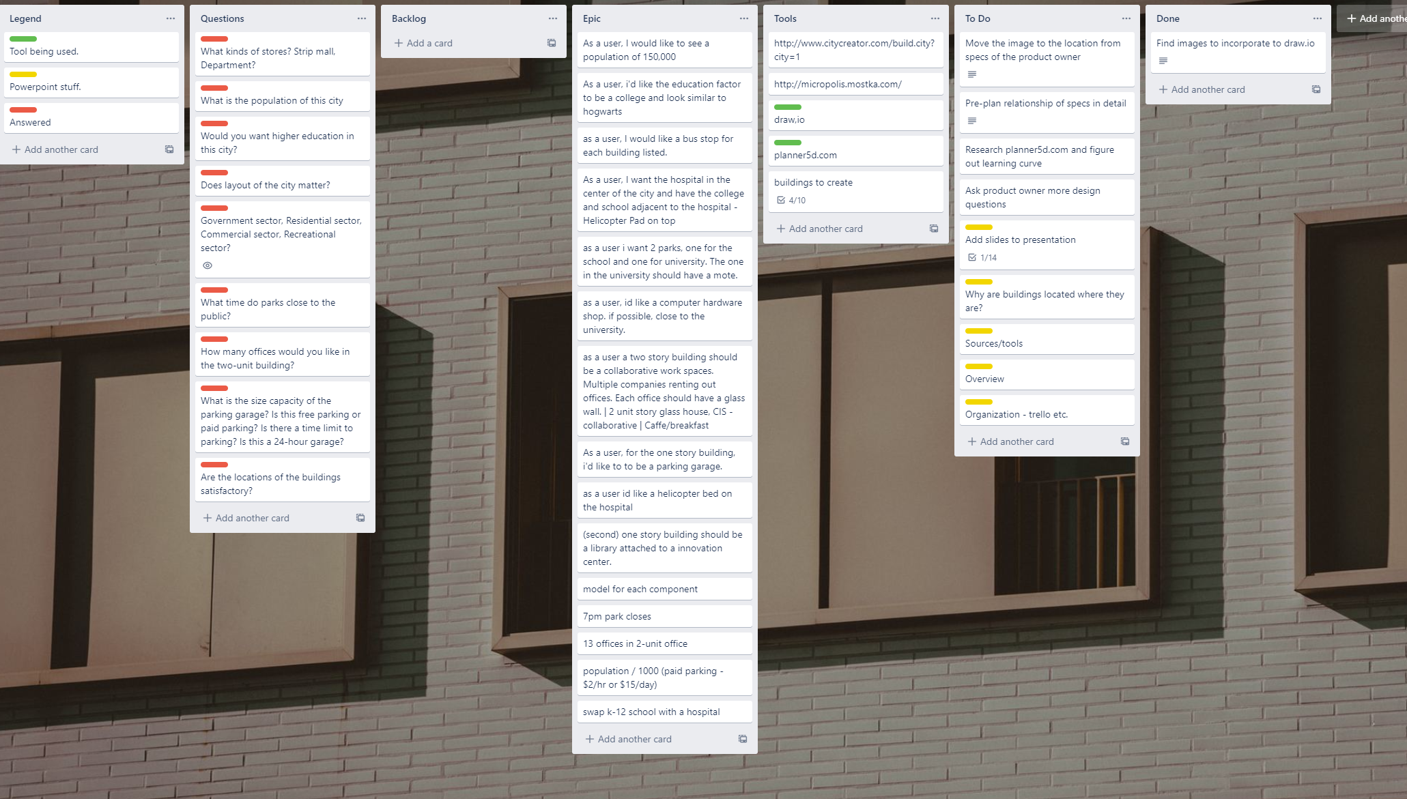
Epic Con.

Slide 4
Epic
User stories for the product included:
A city with a population of 150,000
A University with looks similar to Hogwarts
A bus stop for each building listed
A hospital in the center of the city
K-12 & University adjacent to hospital and equidistant

Slide 5
Epic Continued
Computer hardware store (close to University)
Two story building with 13 offices
One Story Building to be parking garage
Hospital with helicopter pad
Two parks ( one in University surrounded by moat & one for k-12 public school)

Slide 6
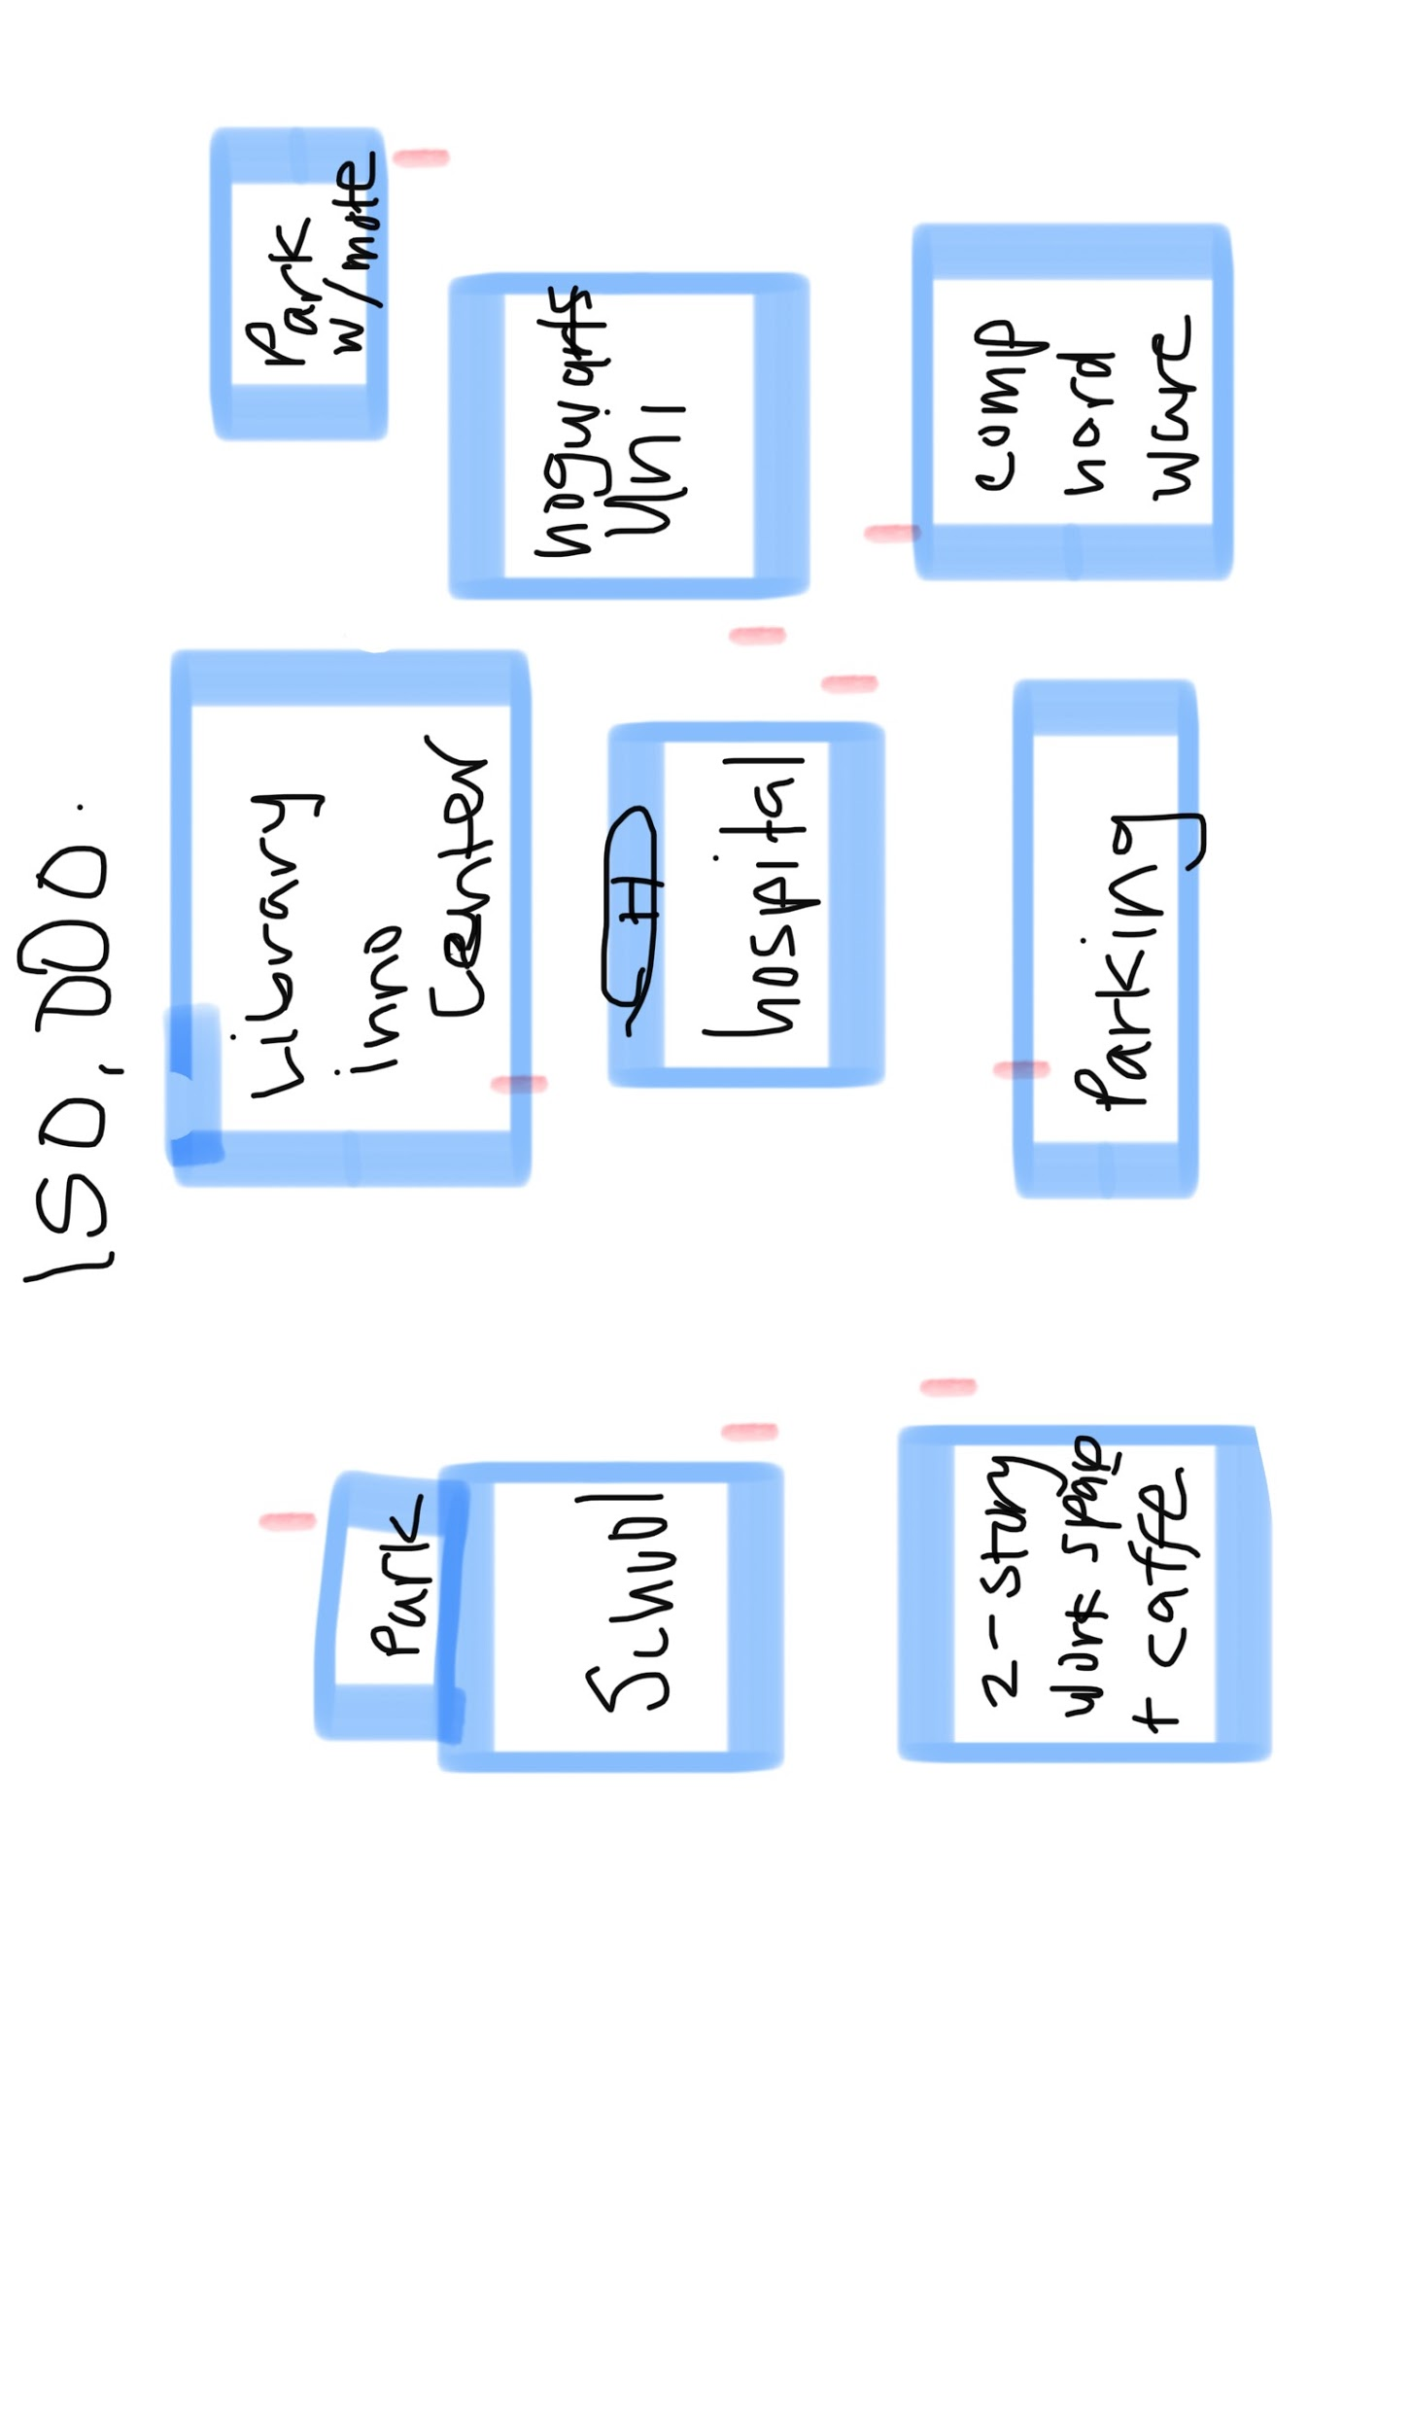
Layout of Leonville Prototype
Red Marks - Bus Stops

Slide 7
WireFrame of Leonville
Click me

Slide 8
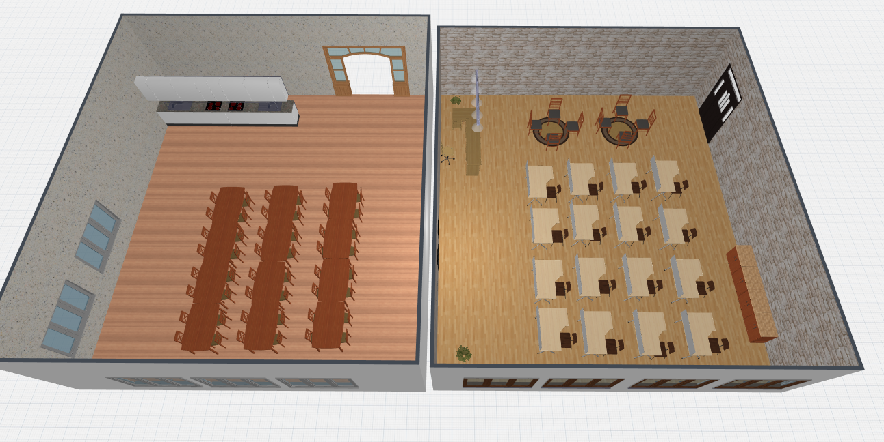
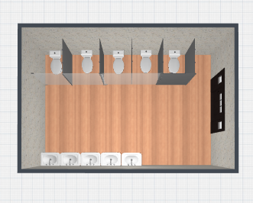
Education K-12 Design
3D Model

Slide 9
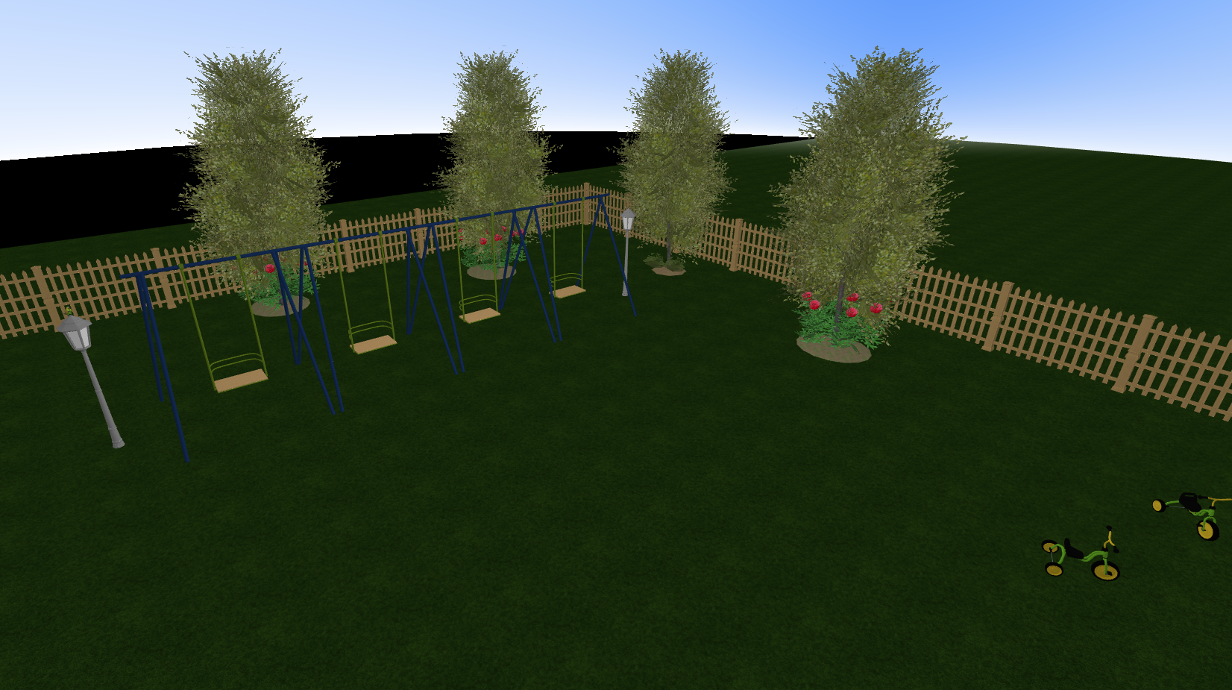
K-12 Park
Swings and tricycles
Fenced in for younger
students’ safety

Slide 10
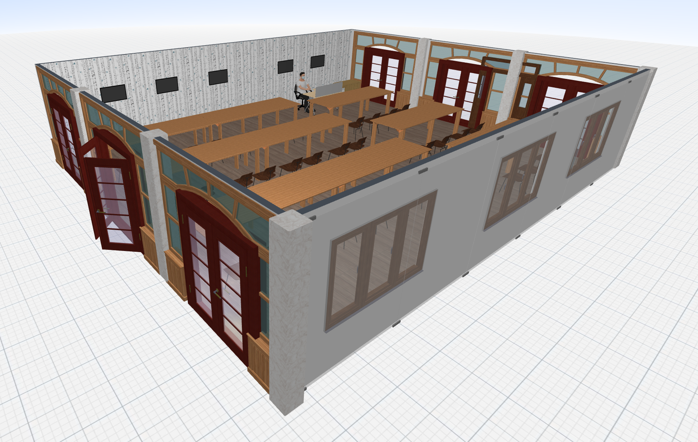
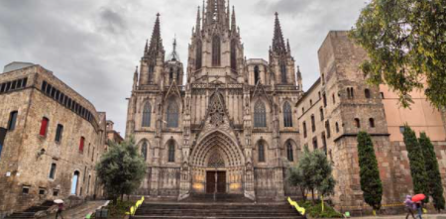
Education University Design
University classroom mockup

Slide 11
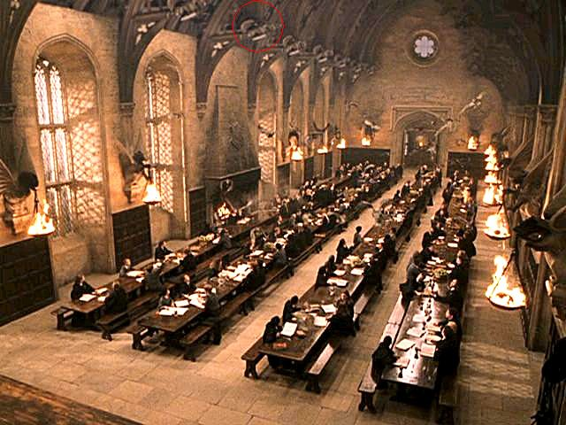
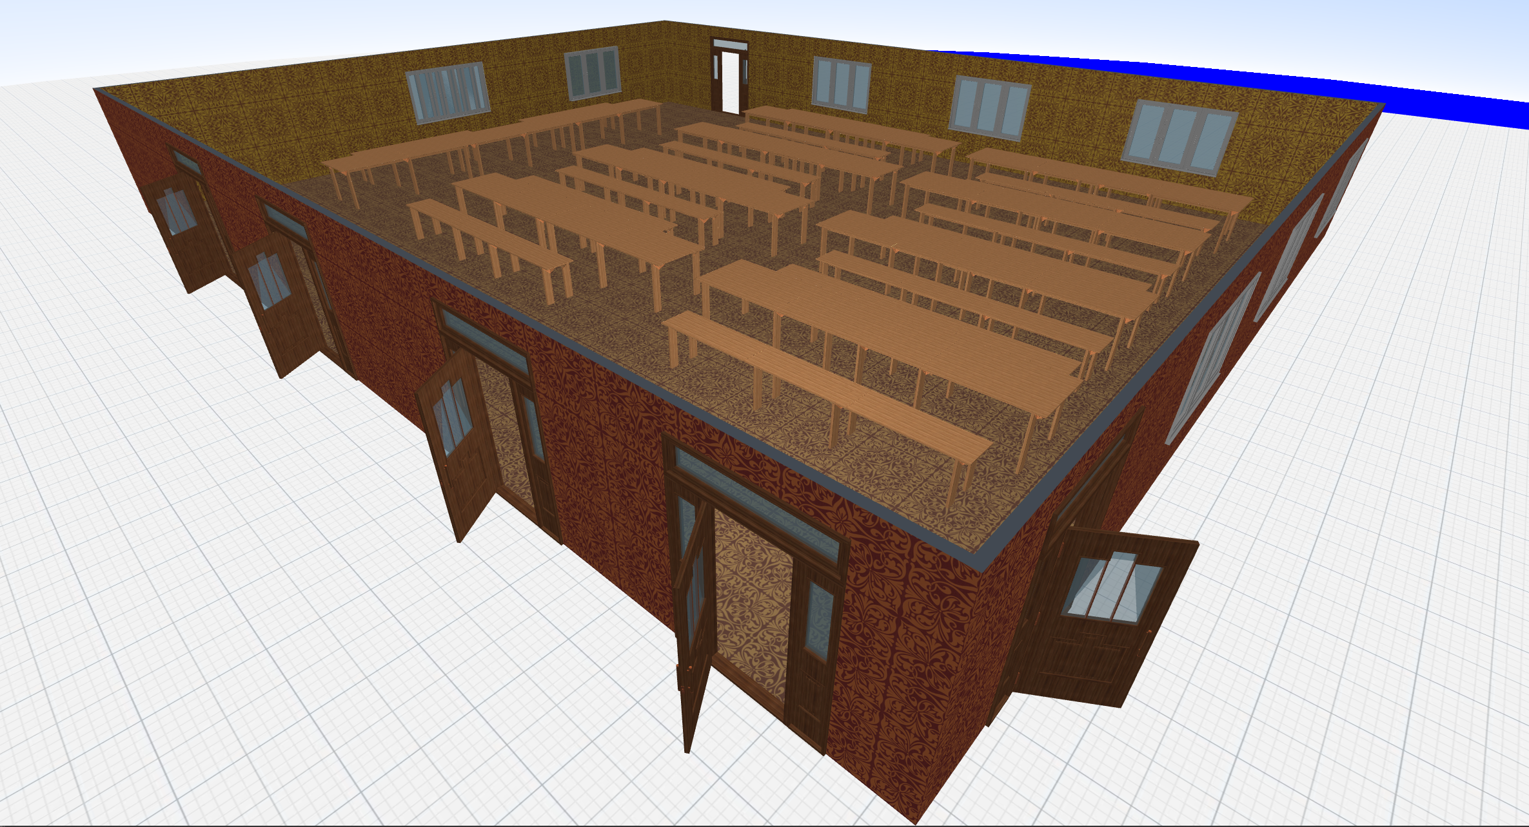
Education Design University
Lunch Room
Mock up (planner5D)

Slide 12
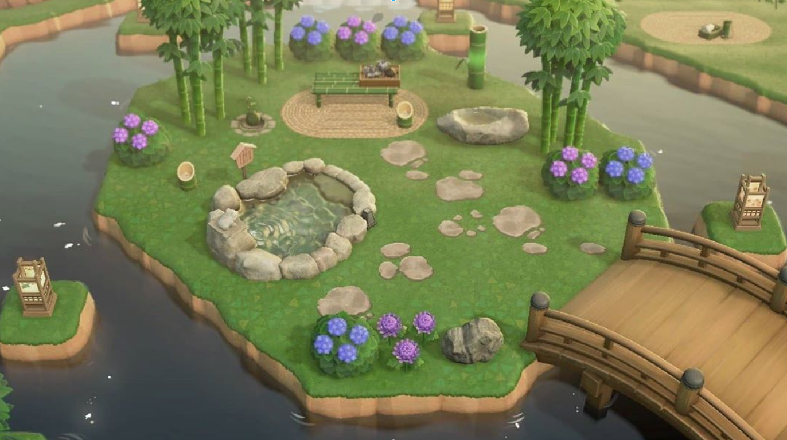
Park Surrounded by Moat
Peaceful park for the nearby University students

Slide 13
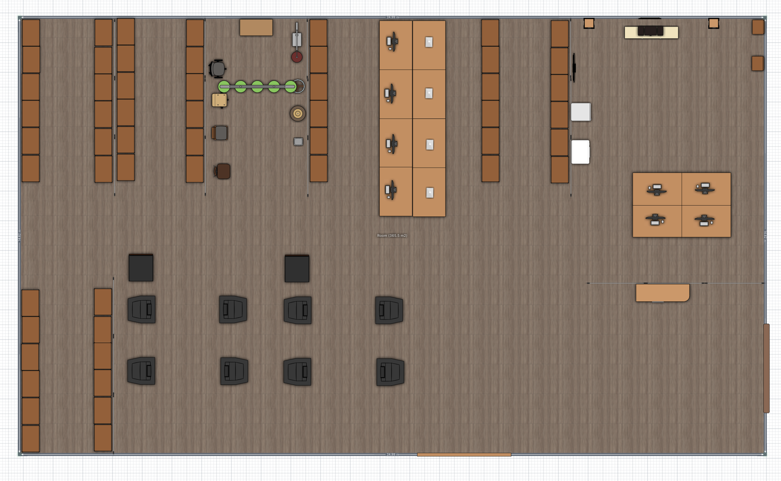
Computer Hardware Store Floor Plan
Various computer parts located on shelves
Self-checkout registers near entrance
Loading dock near entrance
Computers are displayed in the center

Slide 14
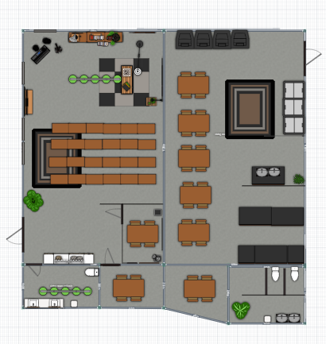
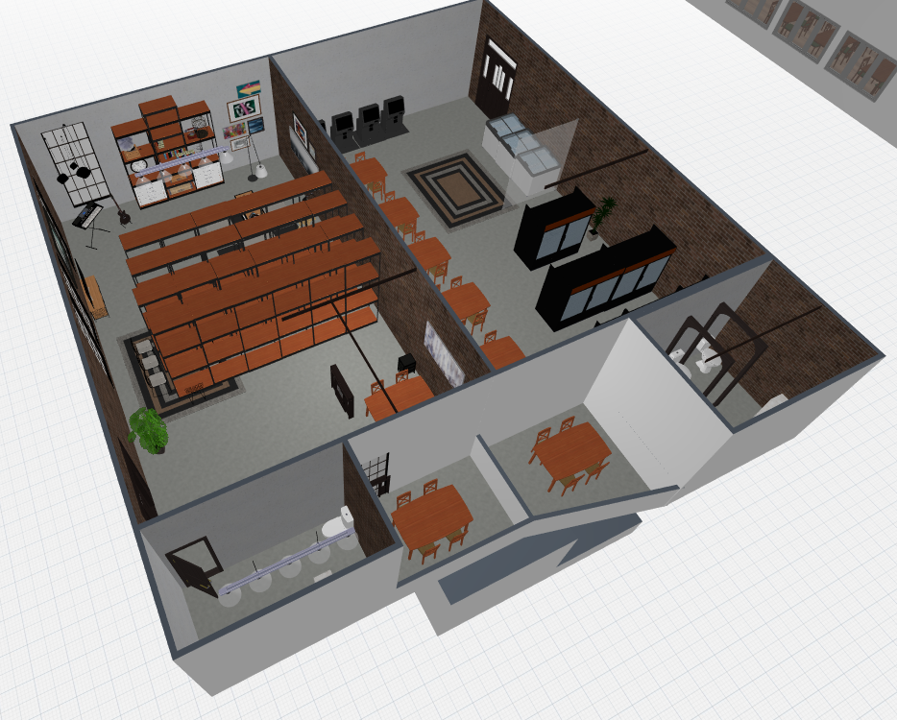
Library and Innovation Room

Slide 15
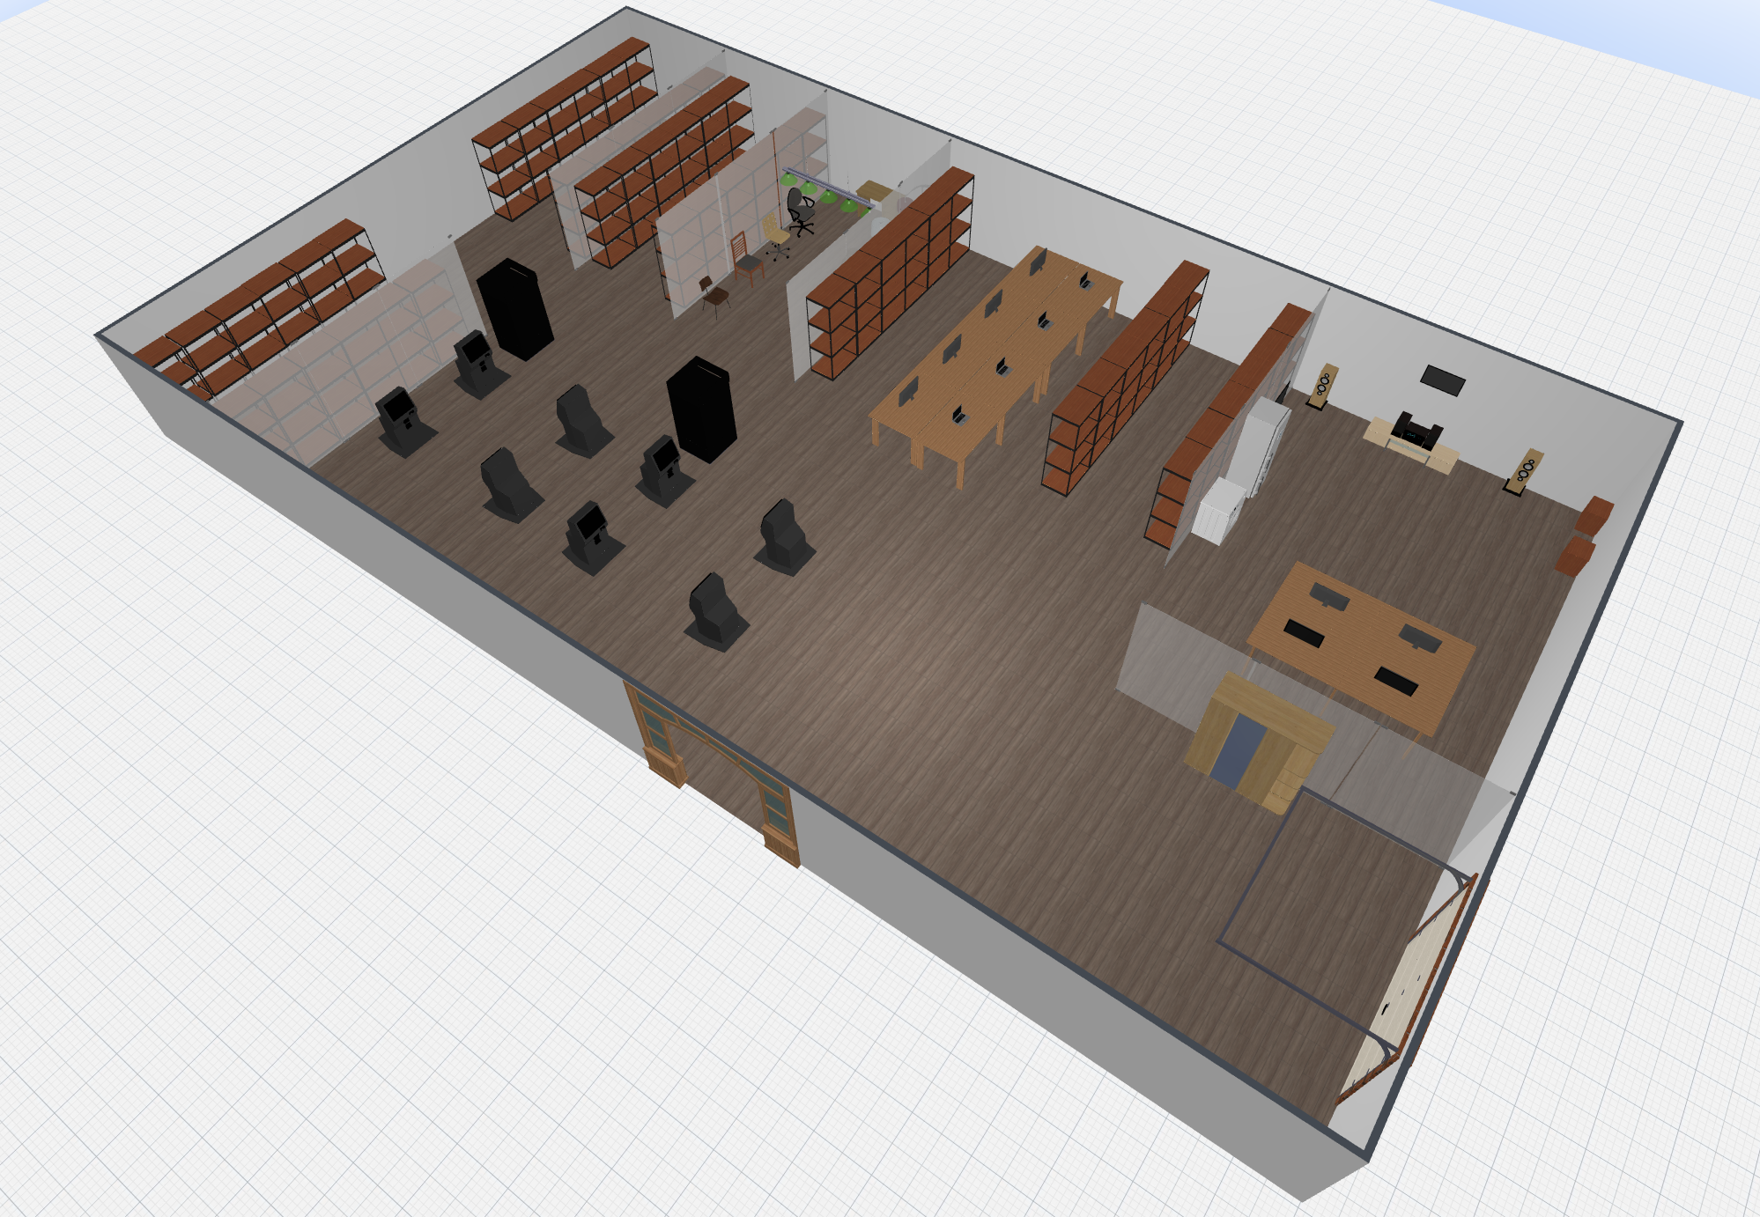
Computer Hardware Store 3D Model

Slide 16
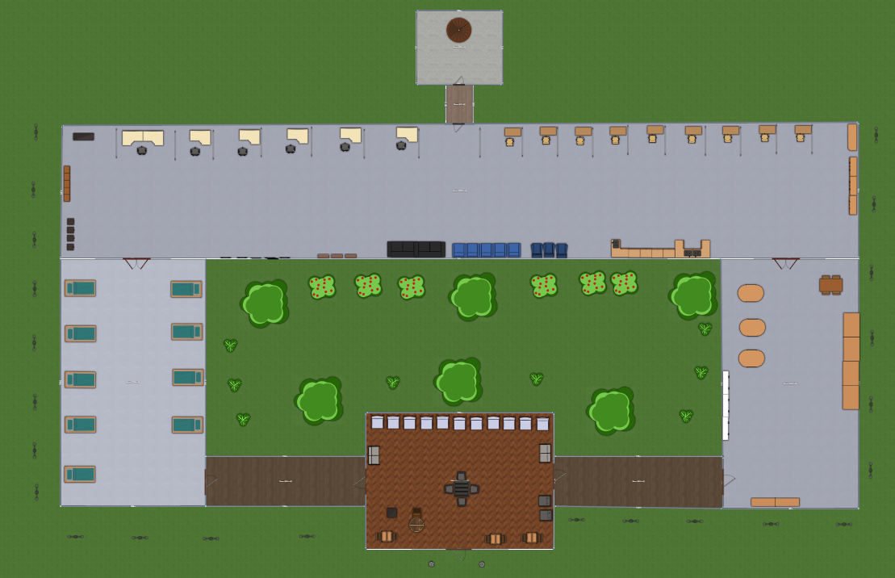
Hospital Floor Plan

Slide 17
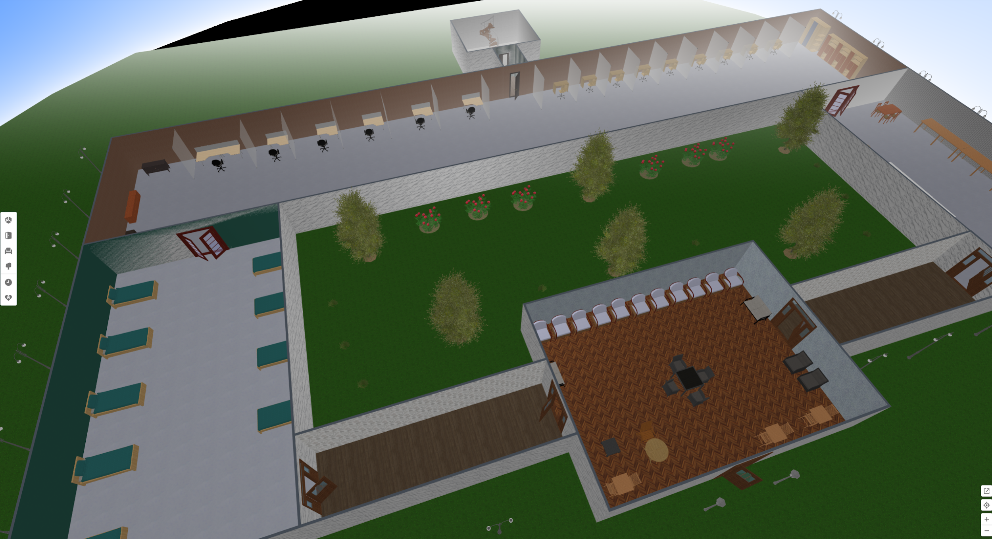
Hospital 3D Model

Slide 18
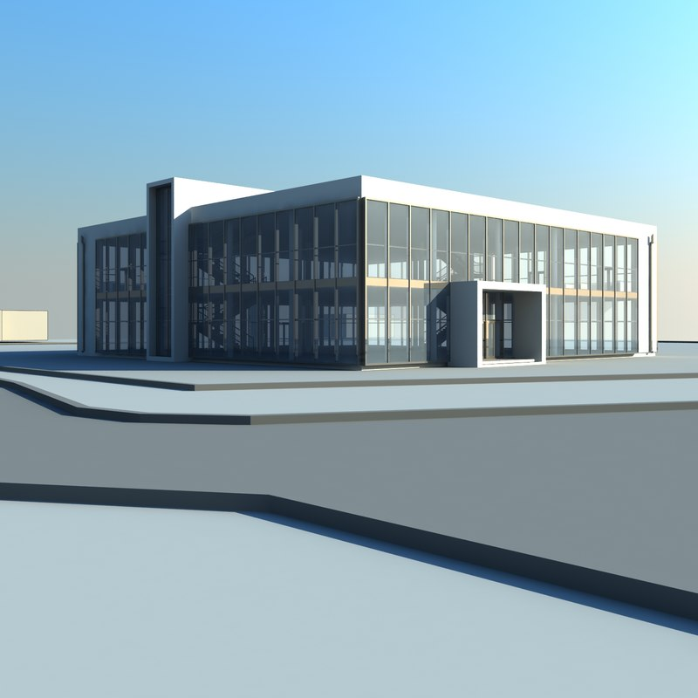
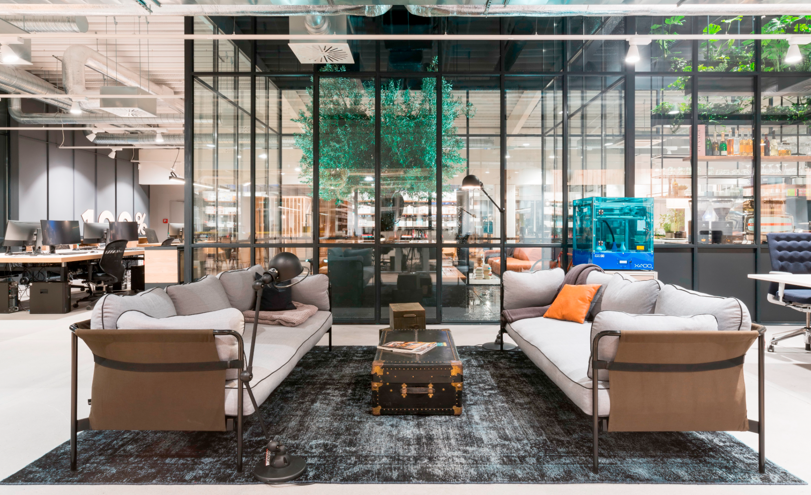
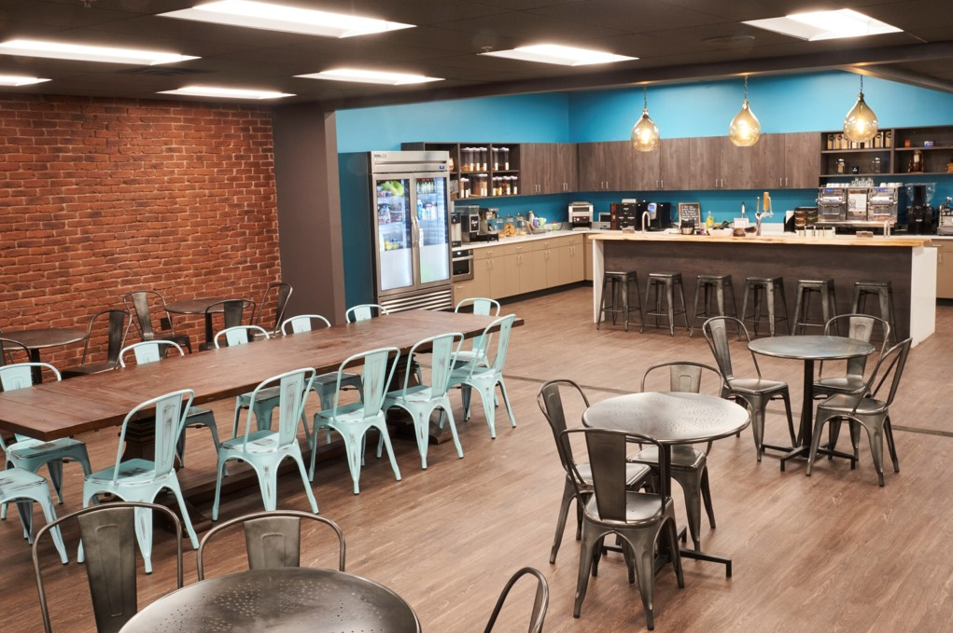
Two-Story Collaboration Center and Cafe

Slide 19
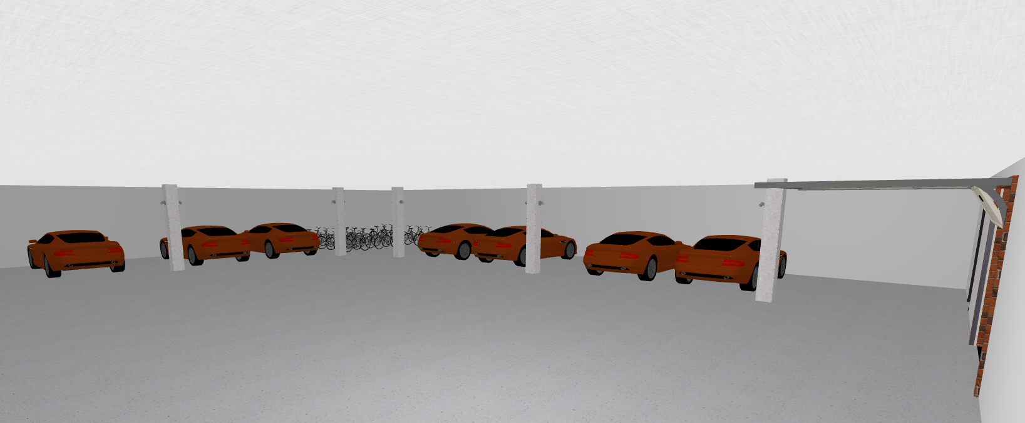
Parking Garage 3D Model
One ground level entrance and exit
Areas inaccessible to motor vehicles reserved for bikes/scooters

Slide 20
Challenges
Learning how to use Planner5D
Time management - Not spending too much time on one asset
Partitioning tasks evenly

Slide 21
Tools Used
Draw.IO
Planner5D
Google Images

